Slide 1
Speech Recognition
Speech Signal Representations

Slide 2
Speech Signal Representations
Fourier Analysis
Discrete-time Fourier transform
Short-time Fourier transform
Discrete Fourier transform
Cepstral Analysis
The “complex cepstrum” and the “real cepstrum”
Computational considerations
Cepstral analysis of speech
Applications to speech recognition
Mel-Frequency cepstral representation
Performance Comparison of Various Representations

Slide 3

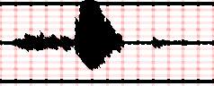
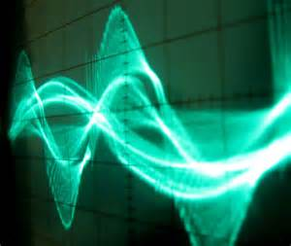
Block Diagram of Speech Recognition Processing
Acoustic Model & Lexicon
P(O|W)
Speaker's Mind
Speech Producer
Acoustic Processor
Decoding Search
W
Speech
O
Ŵ
Speaker
Acoustic Channel
Speech Recognizer
P(W)
Language Model

Slide 4
Decoding and Search
We can see further details of the operationalization in Figure which shows (next slide) the components of an HMM speech recognizer as it processes a single utterance.
The figure shows the recognition process in three stages.
In the feature extraction or signal processing stage, the acoustic waveform is sampled into frames (usually of 10, 15, 20, or 30 milliseconds) which are transformed into spectral features.
Each time window is thus represented by a vector of around 39 features representing this spectral information as well as information about energy and spectral change.

Slide 5
Schematic Simplified Architecture of Speech Recognizer

Slide 6
Decoding and Search
In the acoustic modeling (or phone recognition) stage, we compute the likelihood of the observed spectral feature vectors given linguistic units (words, syllables, phones, subparts of phones, etc.).
For example, we use Gaussian Mixture Model (GMM) classifiers to compute for each HMM state q, corresponding to a phone (or subphone), the likelihood of a given feature vector given this phone p(o|q).
A (simplified) way of thinking of the output of this stage is as a sequence of probability vectors, one for each time frame, each vector at each time frame containing the likelihoods that each phone (or subphone) unit generated the acoustic feature vector observation at that time.

Slide 7
Feature Extraction:
Mel-Filtered Cepstral Coefficient (MFCC) Vectors

Slide 8
MFCC Feature Extraction
Extracting a sequence of 39-dimensional MFCC feature vectors from a quantized digitized waveform

Slide 9
Feature Extraction: MFCC Vectors
Feature Vectors:
Our goal in this section is to describe how we transform the input waveform into a sequence of acoustic feature vectors, each vector representing the information in a small time window of the signal. While there are many possible such feature representations, by far the most common in speech recognition are the MFCC’s: the mel frequency cepstral coefficients.
Mel Frequency Cepstral Coefficients:
These are based on the important idea of the cepstrum. We will give a relatively high-level description of the process of extraction of MFCCs from a waveform; we strongly encourage students interested in more detail to follow up with a speech signal processing course.

Slide 10
Feature Extraction: MFCC Vectors
Analog-to-Digital Conversion
We begin with the process of digitizing and quantizing an analog speech waveform. Recall that the first step in processing speech is to convert the analog representations (first air pressure, and then analog electric signals in a microphone), into a digital signal. This process of analog-to-digital conversion has two steps:
sampling and
quantization.

Slide 11
Sampling Quantization
Sampling Rate
Number of Quantization Levels
Precision (Bits per Sample)

Slide 12
Feature Extraction: MFCC Vectors
Sampling, Sampling Rate, Nyqist Frequency, :
A signal is sampled by measuring its amplitude at a particular time; the sampling rate is the number of samples taken per second. In order to accurately measure a wave, it is necessary to have at least two samples in each cycle: one measuring the positive part of the wave and one measuring the negative part.
More than two samples per cycle increases the amplitude accuracy, but less than two samples will cause the frequency of the wave to be completely missed. Thus the maximum frequency wave that can be measured is one whose frequency is half the sample rate (since every cycle needs two samples). This maximum frequency for a given sampling rate is called the Nyquist frequency.

Slide 13
Bandwidth and Sample Rate
Most information in human speech is in frequencies below 10,000 Hz; thus a 20,000 Hz sampling rate would be necessary for complete accuracy.
But telephone speech is filtered by the switching network, and only frequencies less than 4,000 Hz are transmitted by telephones. Thus an 8,000 Hz sampling rate is sufficient for telephone-bandwidth speech like the Switchboard corpus.
A 16,000 Hz sampling rate (sometimes called wideband) is often used for microphone speech.

Slide 14
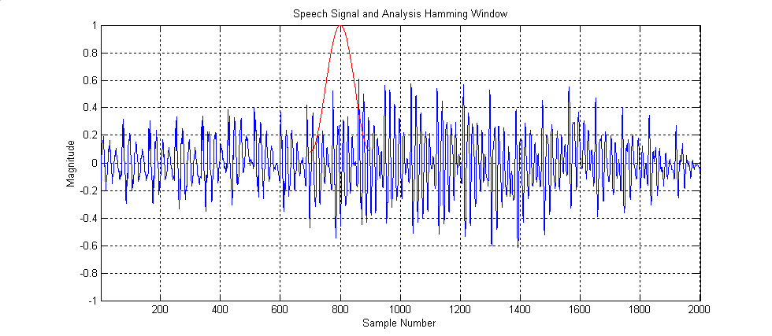
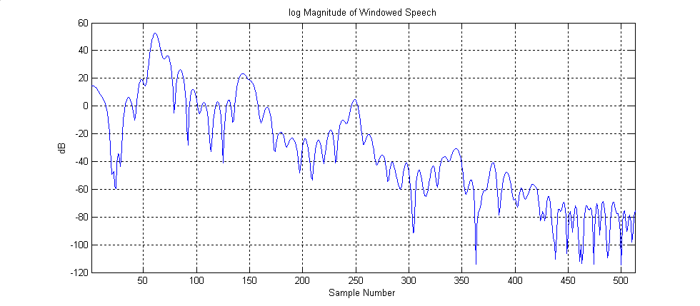
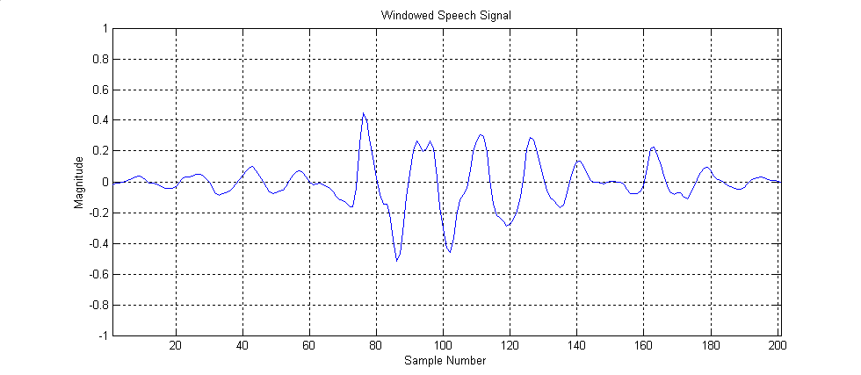
MFCC Feature Extraction
Pre-emphasis
FFT
log
Windowing
Mel-Filter
IFFT

Slide 15
Pre-emphasis Filter
Input Signal x
Output Signal y
Pre-emphasis Filter

Slide 16
MFCC Feature Extraction
Pre-emphasis
FFT
log
Windowing
Mel-Filter
IFFT

Slide 17
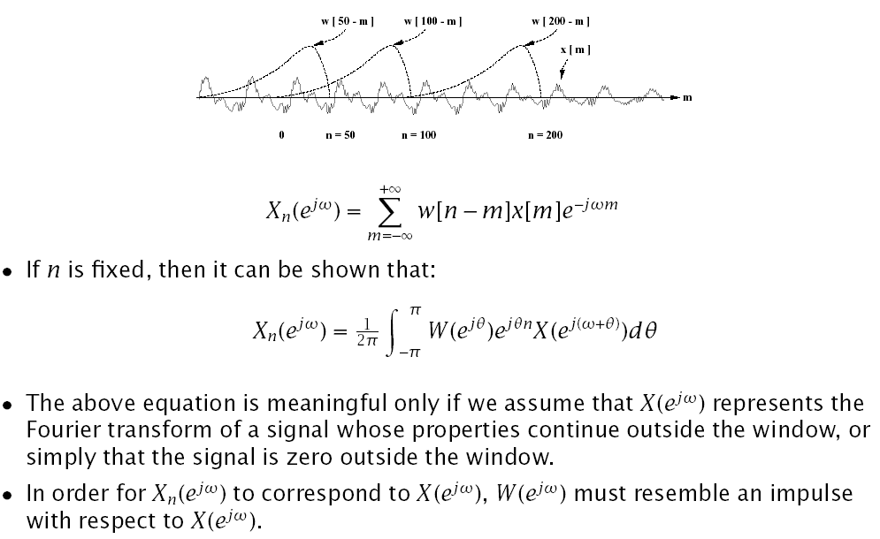
Short-Time Fourier Analysis (Time-Dependent Fourier Transform)

Slide 18
Short-Time Analysis

Slide 19
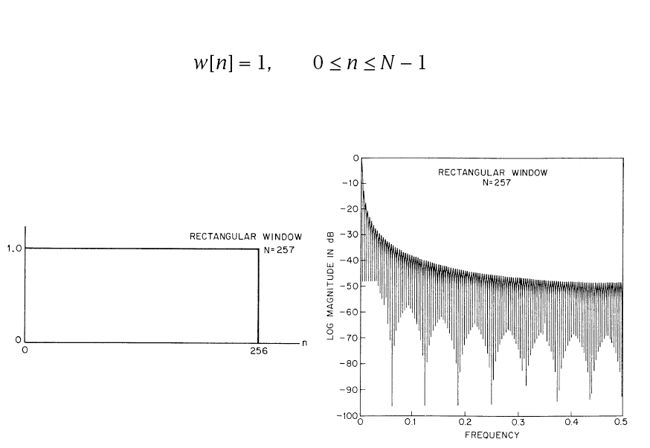
Rectangular Window

Slide 20
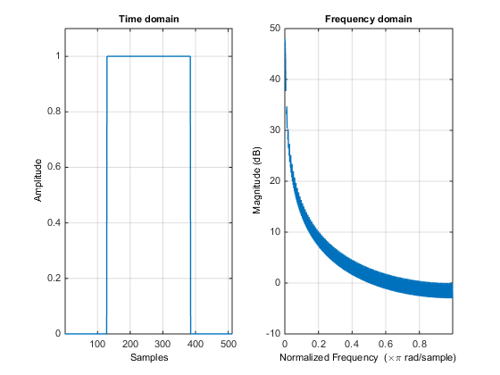
MATLAB wintool
Figure
Code
>> one = ones(256, 1);
>> zer = zeros(256/2, 1);
>> w = [zer; one; zer];
Use w in wintool
wintool:
Type: User Defined
Matlab code: w
Length: 512

Slide 21
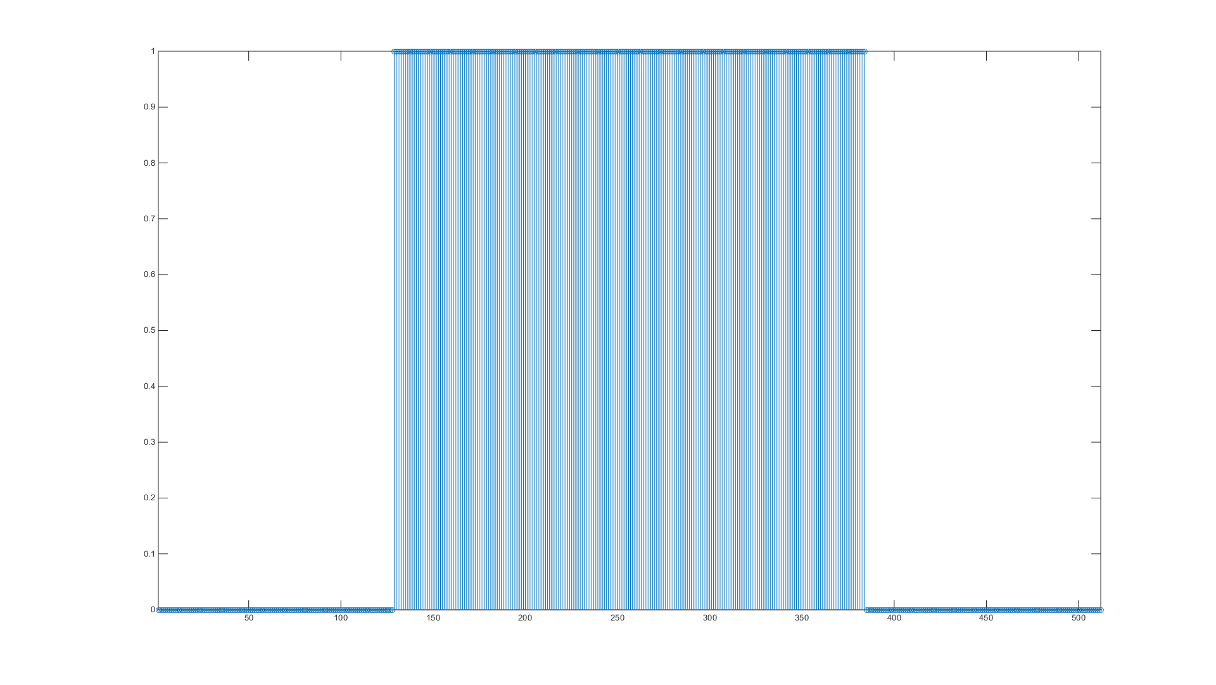
Rectangular Window step plot

Slide 22
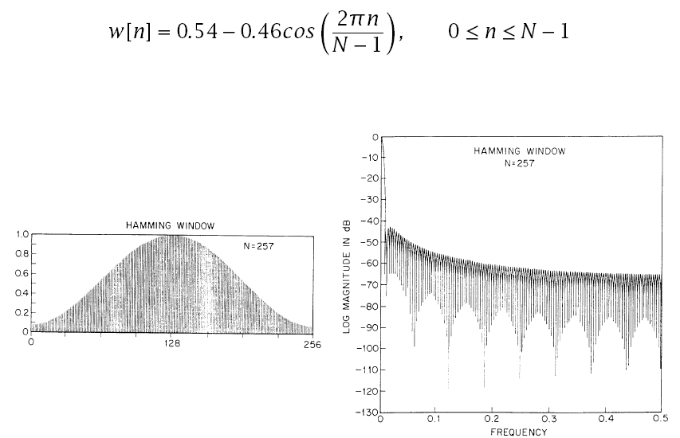
Hamming Window

Slide 23
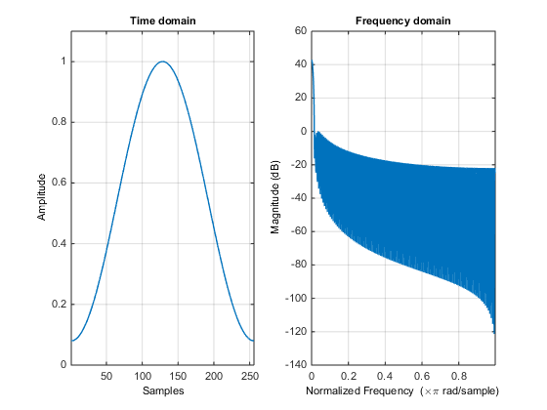
Hamming Window

Slide 24
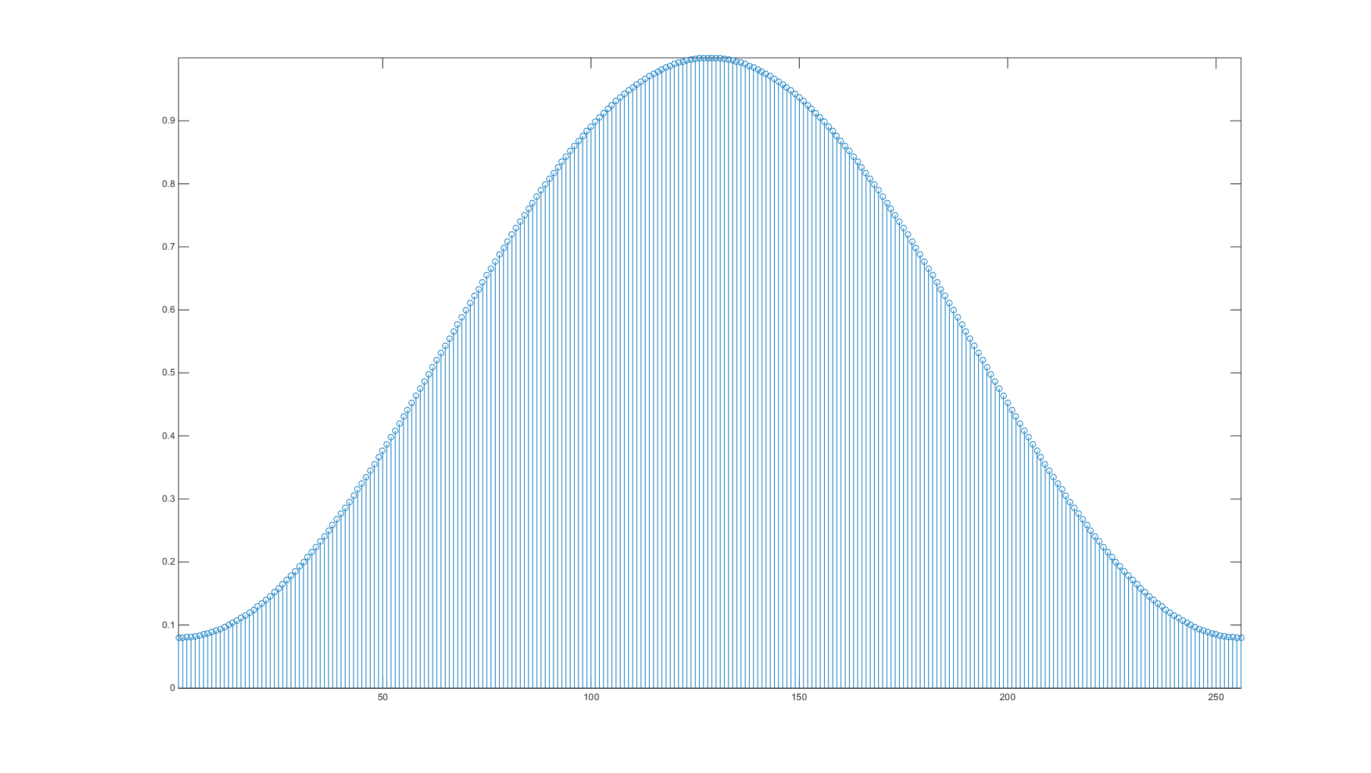
Hamming Window Stem plot

Slide 25
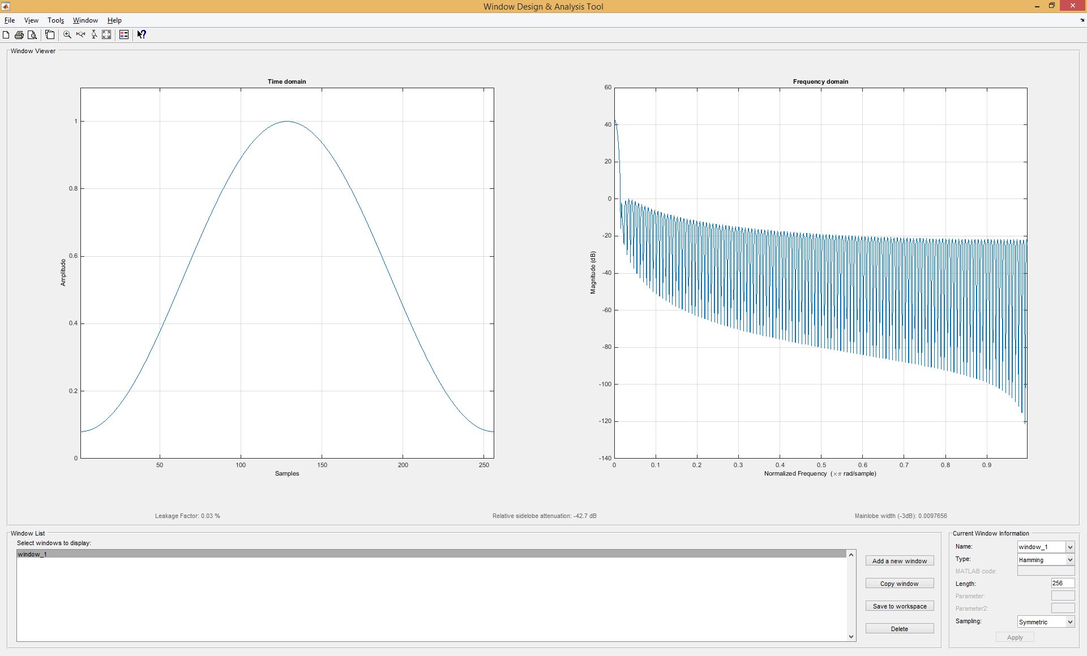
>wintool

Slide 26
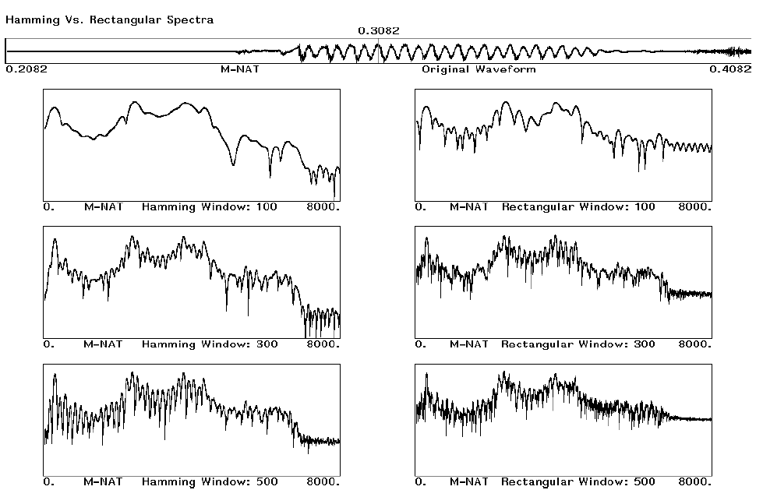
Comparison of Windows

Slide 27
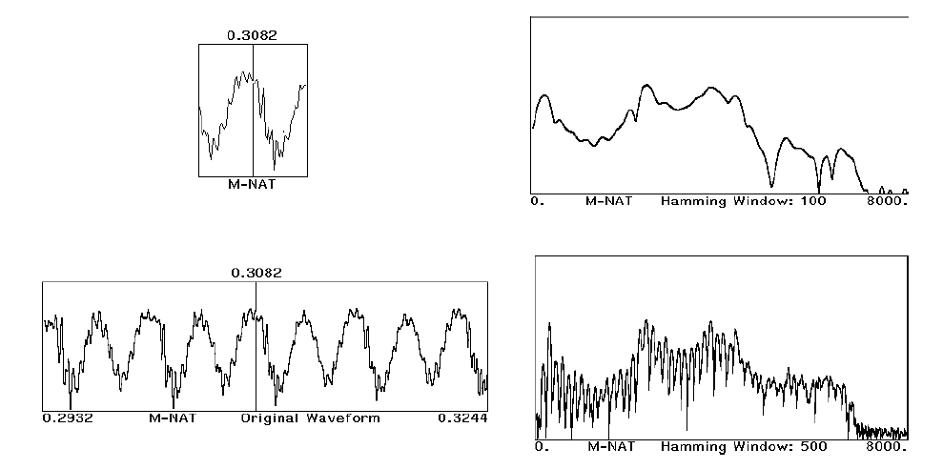
Comparison of Windows (cont’d)

Slide 28
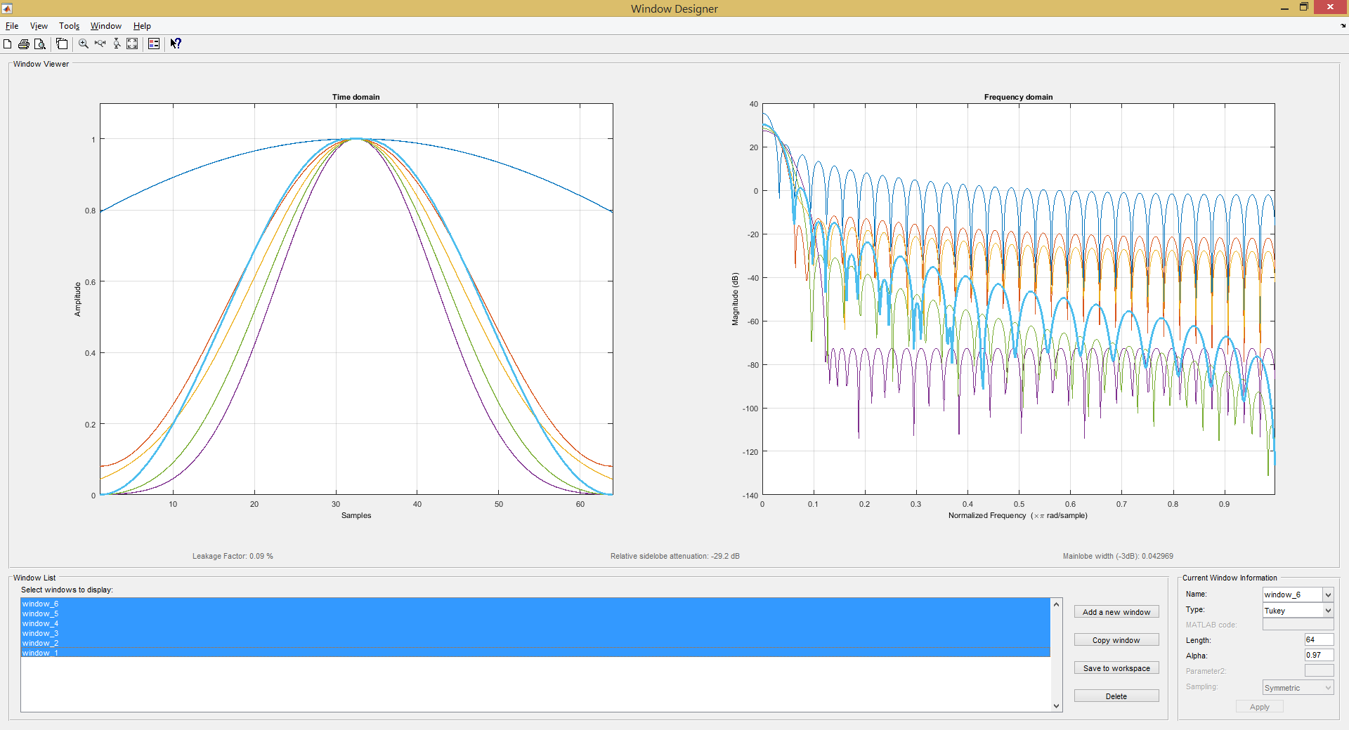
Window Comparison (matlab)

Slide 29
MFCC Feature Extraction
Pre-emphasis
FFT
log
Windowing
Mel-Filter
IFFT

Slide 30
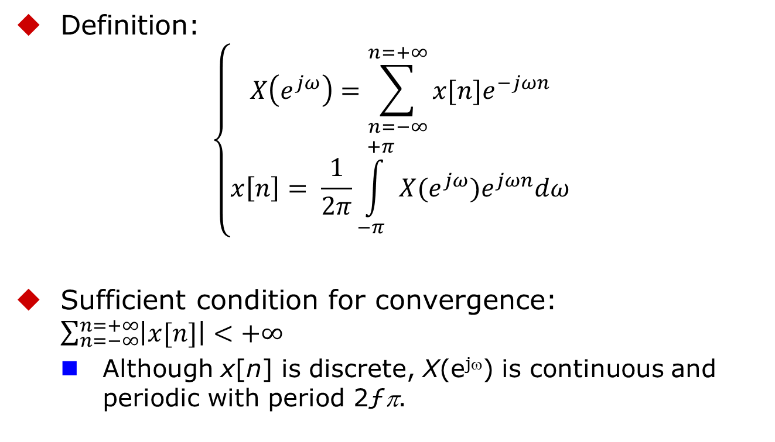
Discrete-Time Fourier Transform
Definition:
$$\left\{\begin{matrix}X\left(e^{jω}\right)=\sum_{n=−∞}^{n=+∞}{x[n]e^{−jωn}} \\ x\left[n\right]= \frac{1}{2π}\int_{−π}^{+π}{X(e^{jω})e^{jωn}dω}\end{matrix}\right.$$
Sufficient condition for convergence: $\sum_{n=−∞}^{n=+∞}{\left|x[n]\right|<+∞ }$
Although x[n] is discrete, X(e^{jω}) is continuous and periodic with period 2ƒπ.

Slide 31
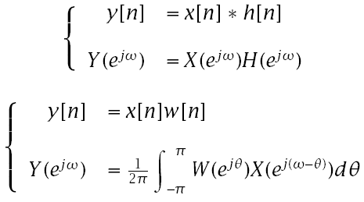
Discrete-Time Fourier Transform
Convolution/multiplication duality:

Slide 32
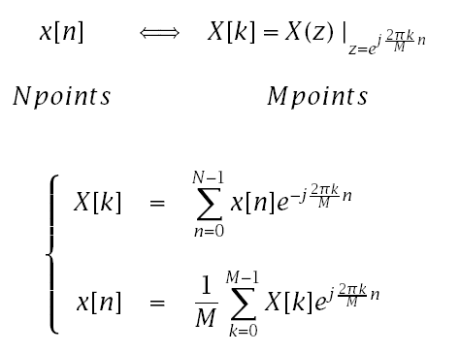
Discrete Fourier Transform
In general, the number of input points, N, and the number of frequency samples, M, need not be the same.
If M>N , we must zero-pad the signal
If M<N , we must time-alias the signal

Slide 33
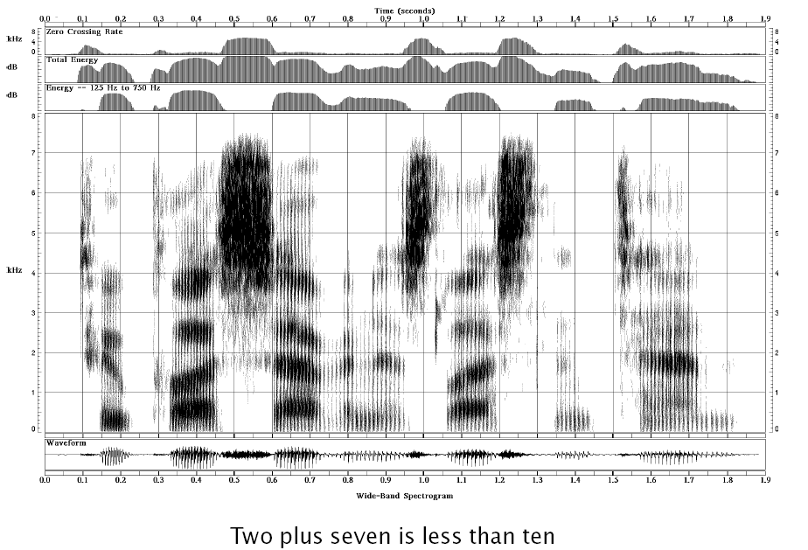
A Wideband Spectrogram

Slide 34
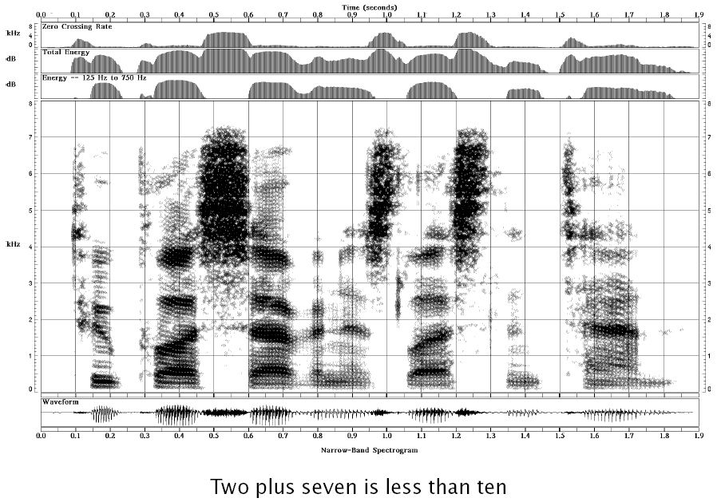
A Narrowband Spectrogram

Slide 35
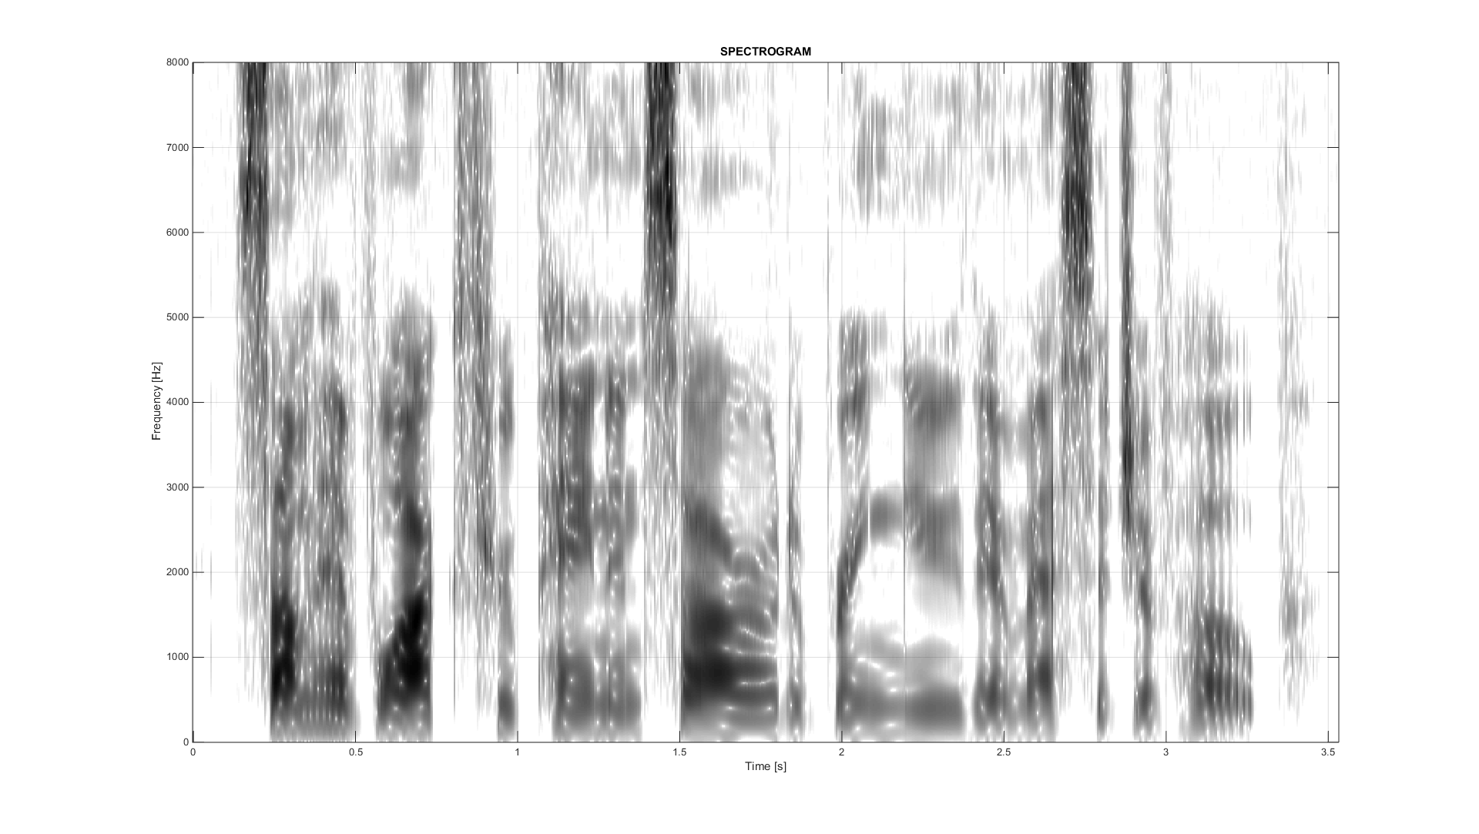
A Narrowband Spectrogram
Some have walked through pain and sorrow to bring you their message of hope

Slide 36
A Narrowband Spectrogram
Some have walked through pain and sorrow to bring you their message of hope

Slide 37
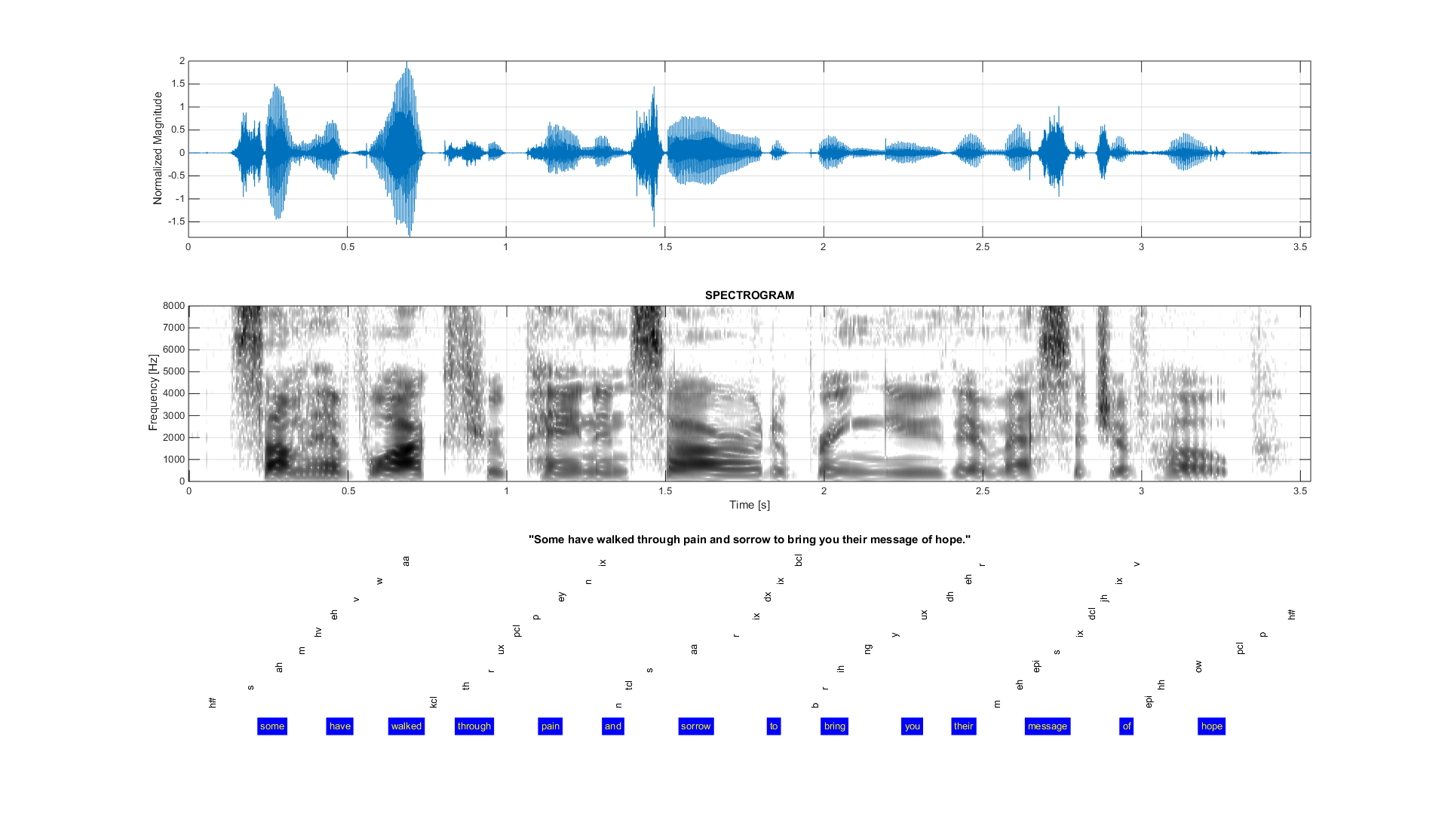

Slide 38
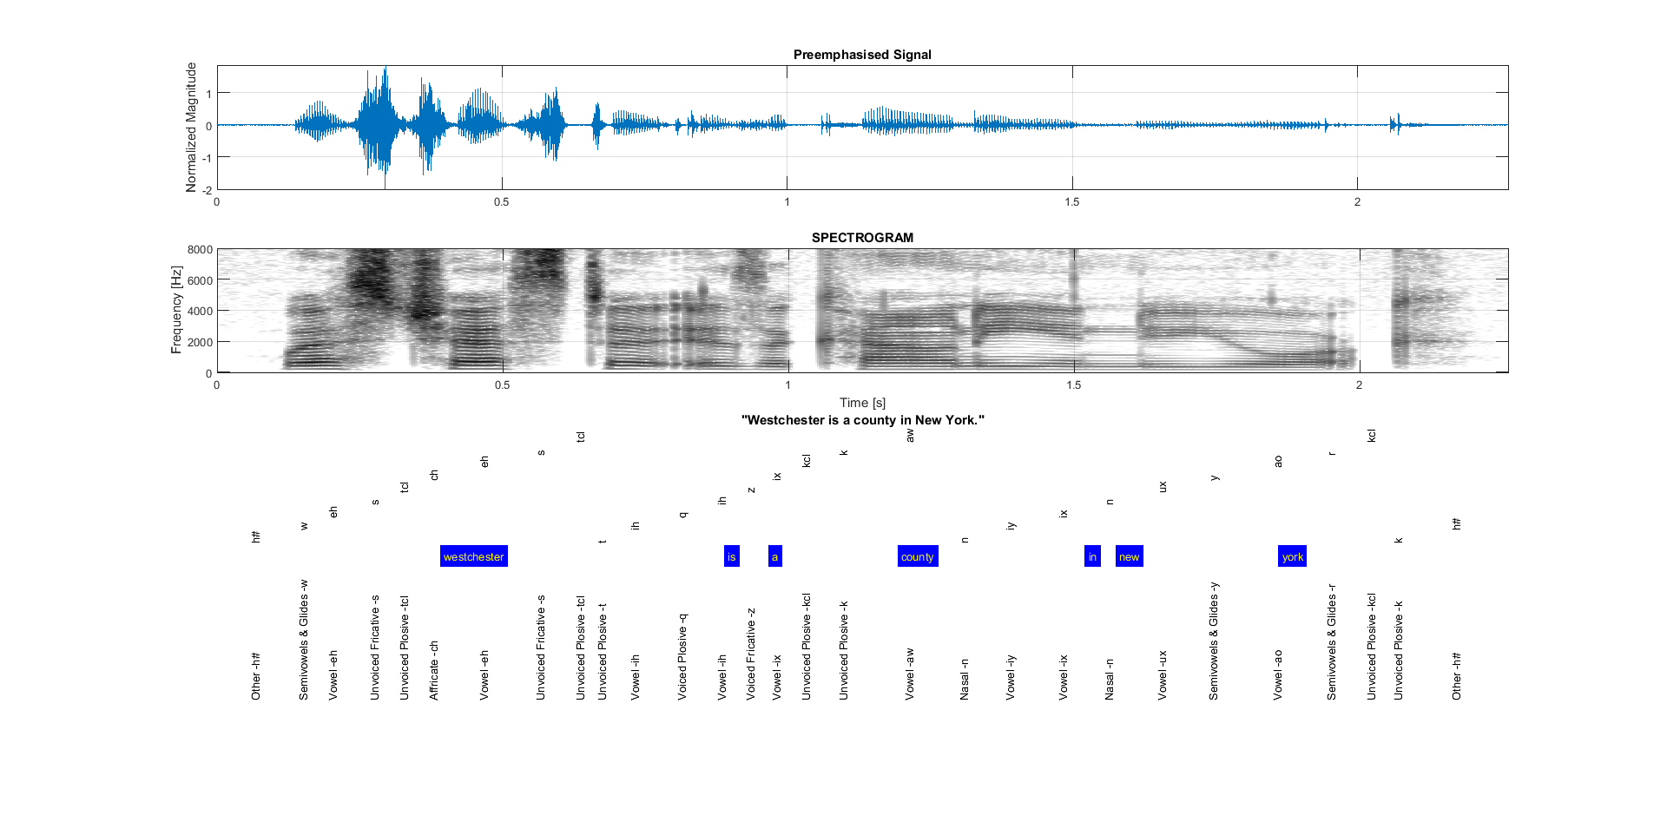

Slide 39
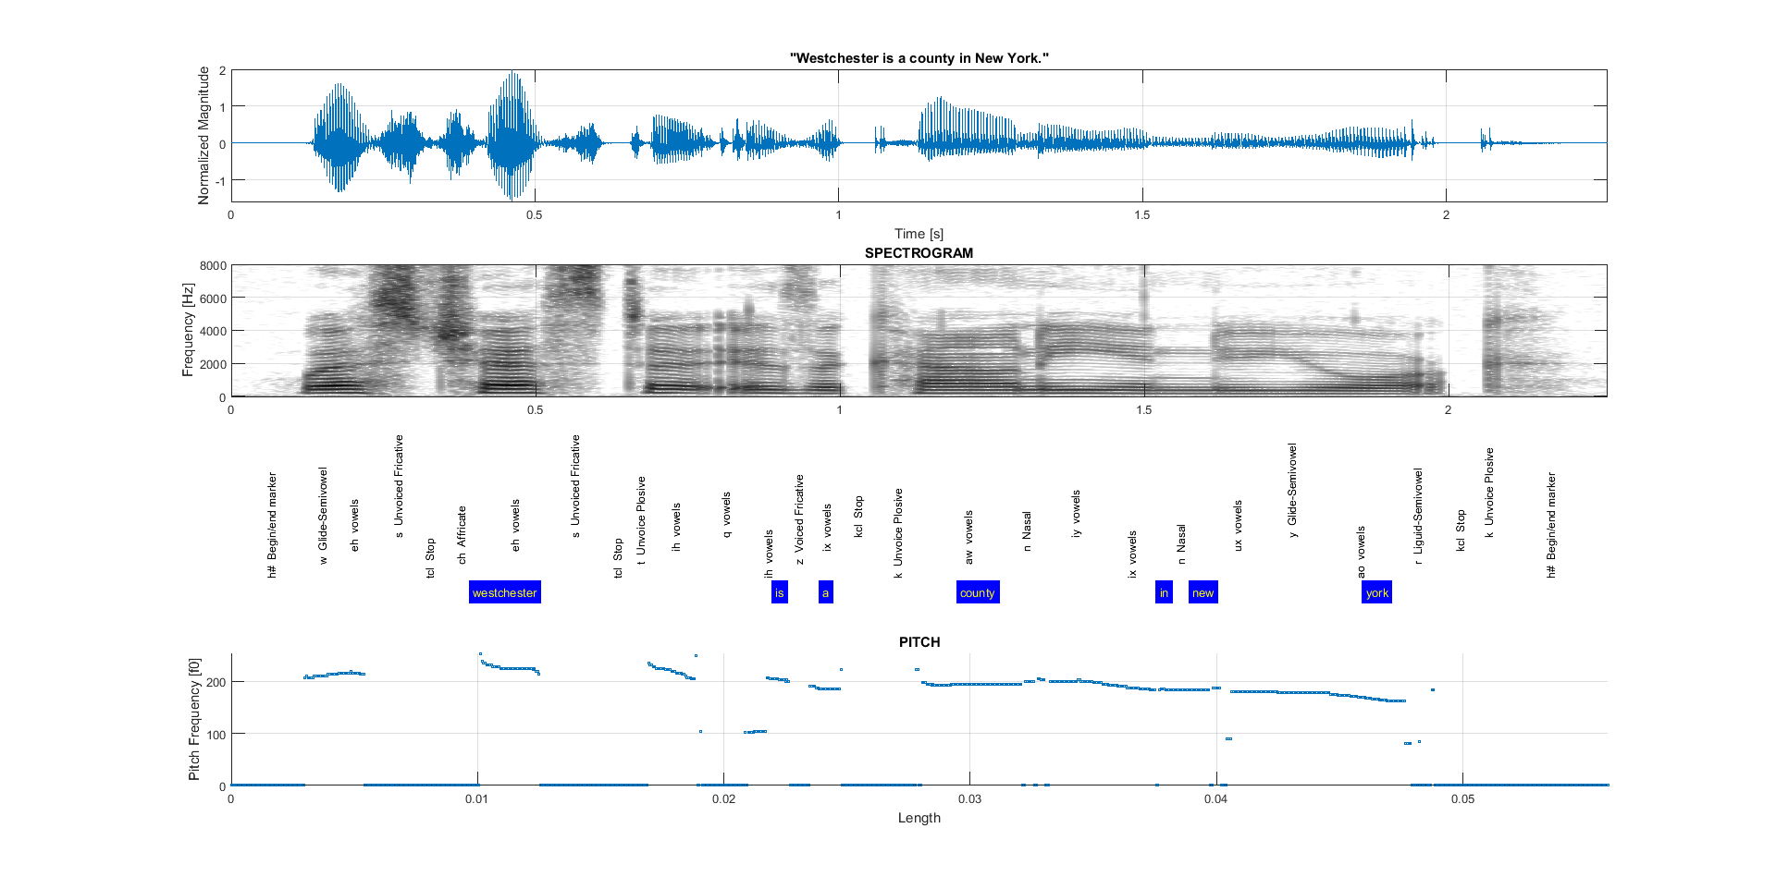

Slide 40
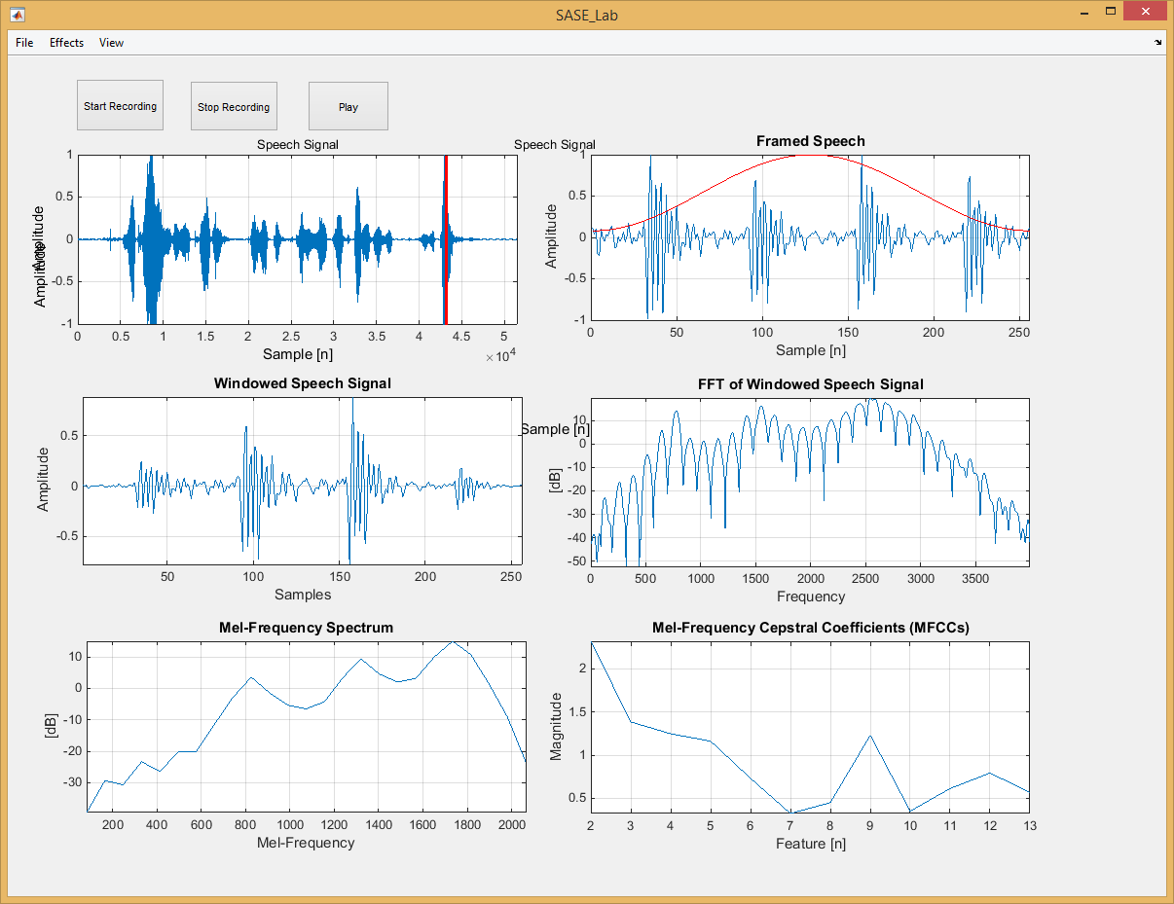

Slide 41
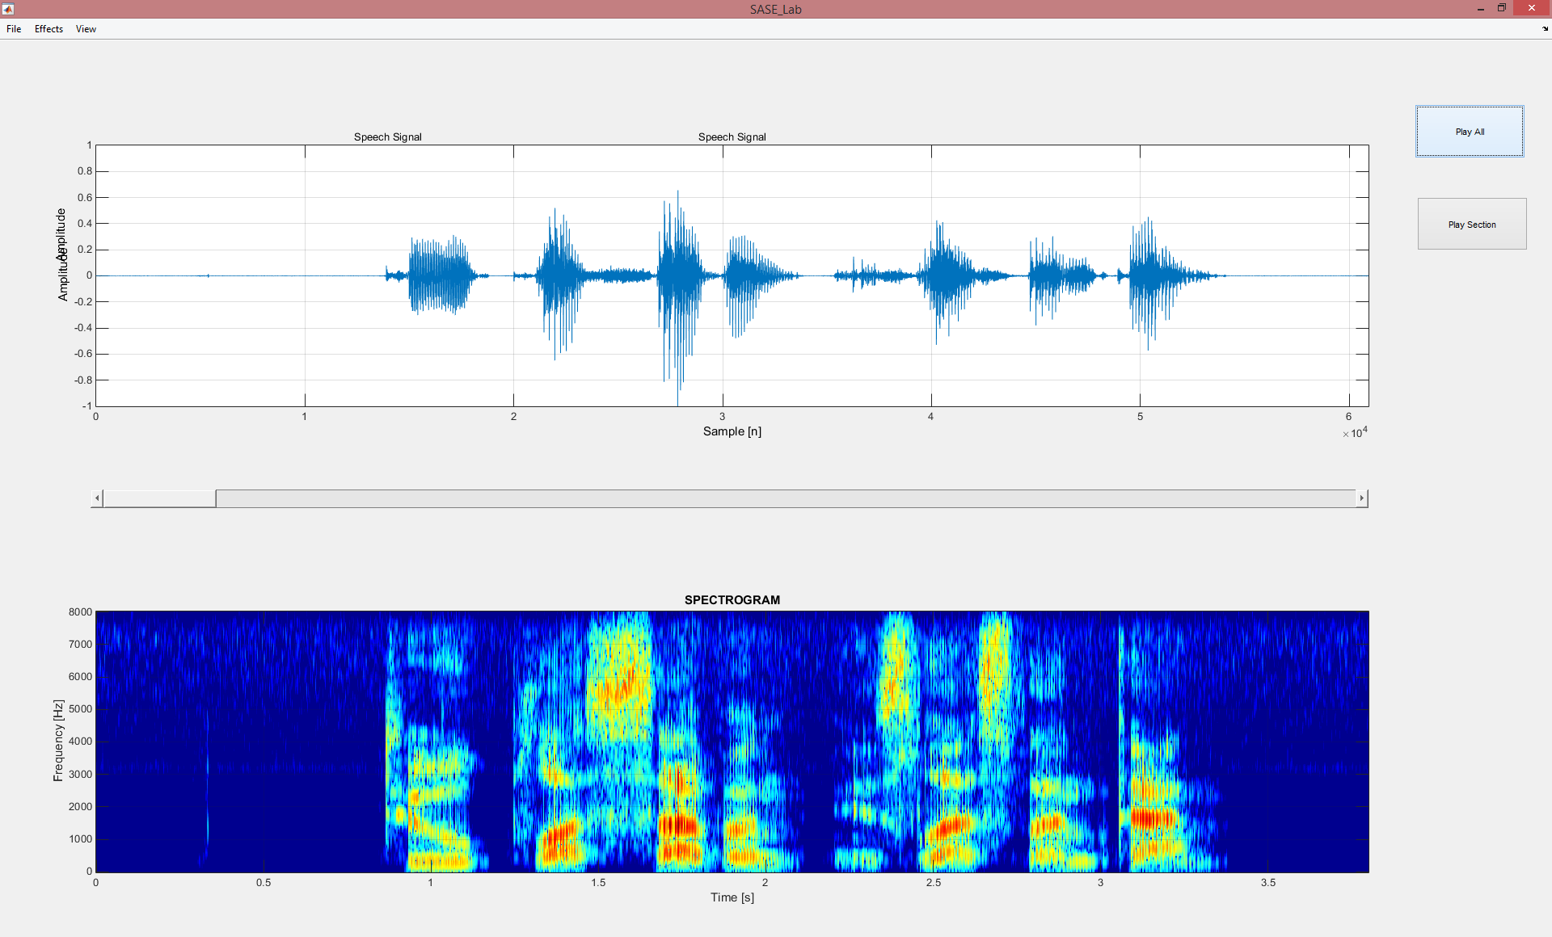

Slide 42
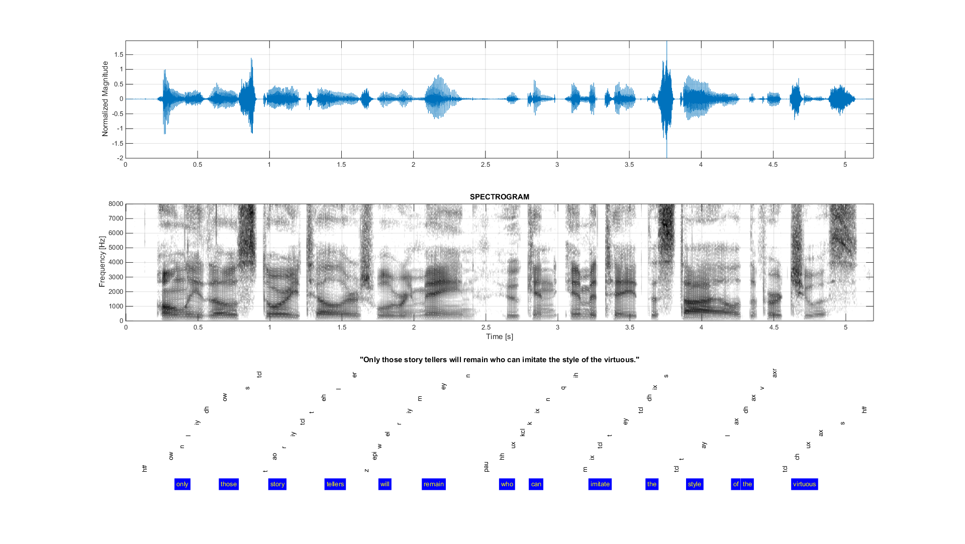

Slide 43
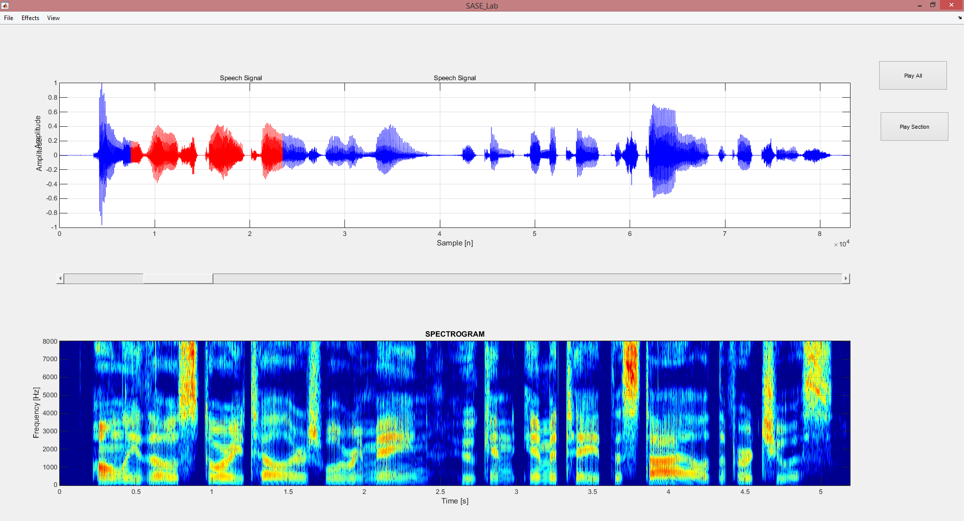

Slide 44
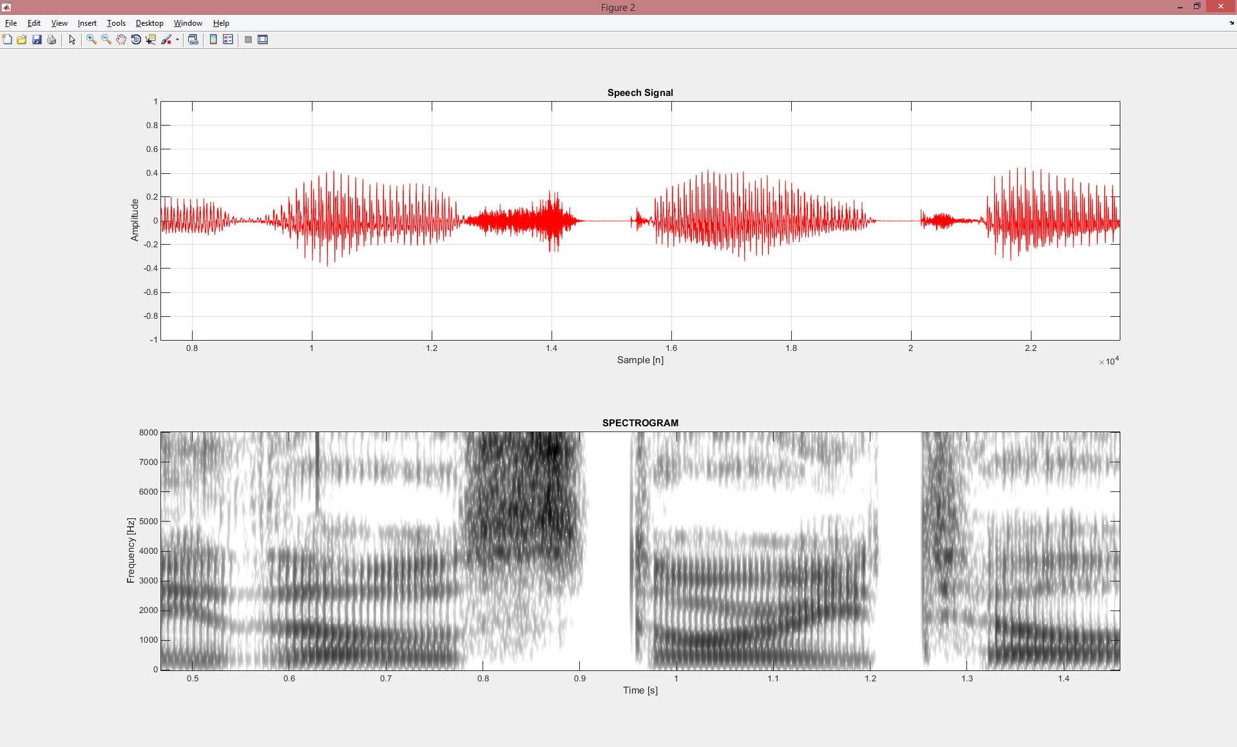

Slide 45
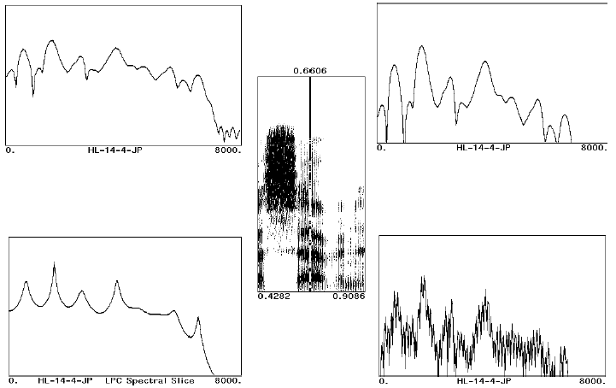
Examples of Various Spectral Representations

Slide 46
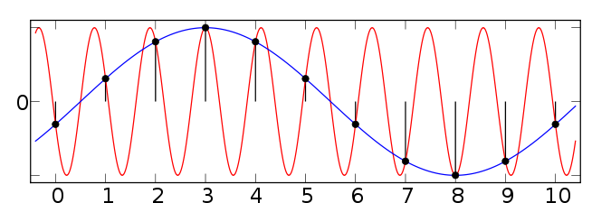
Aliasing

Slide 47
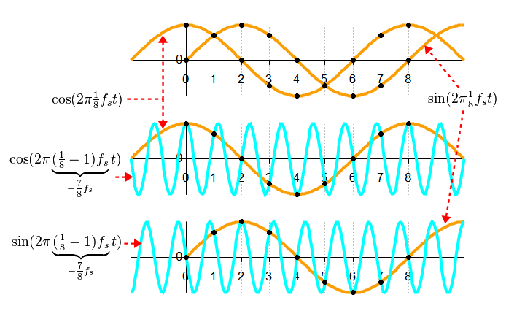
Aliasing: Why we should pay attention.

Slide 48
MFCC Feature Extraction
Pre-emphasis
FFT
log
Windowing
Mel-Filter
IFFT

Slide 49
Mel-Frequency Scale

Slide 50
Mel-Frequency Scale

Slide 51
MFCC Feature Extraction
Pre-emphasis
FFT
log
Windowing
Mel-Filter
IFFT

Slide 52
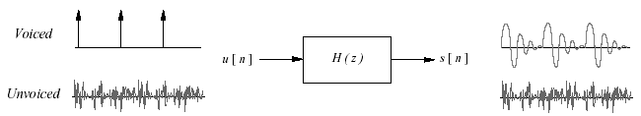
Cepstral Analysis of Speech
The speech signal is often assumed to be the output of an LTI system; i.e., it is the convolution of the input and the impulse response.
If we are interested in characterizing the signal in terms of the parameters of such a model, we must go through the process of de-convolution.
Cepstral, analysis is a common procedure used for such de-convolution

Slide 53
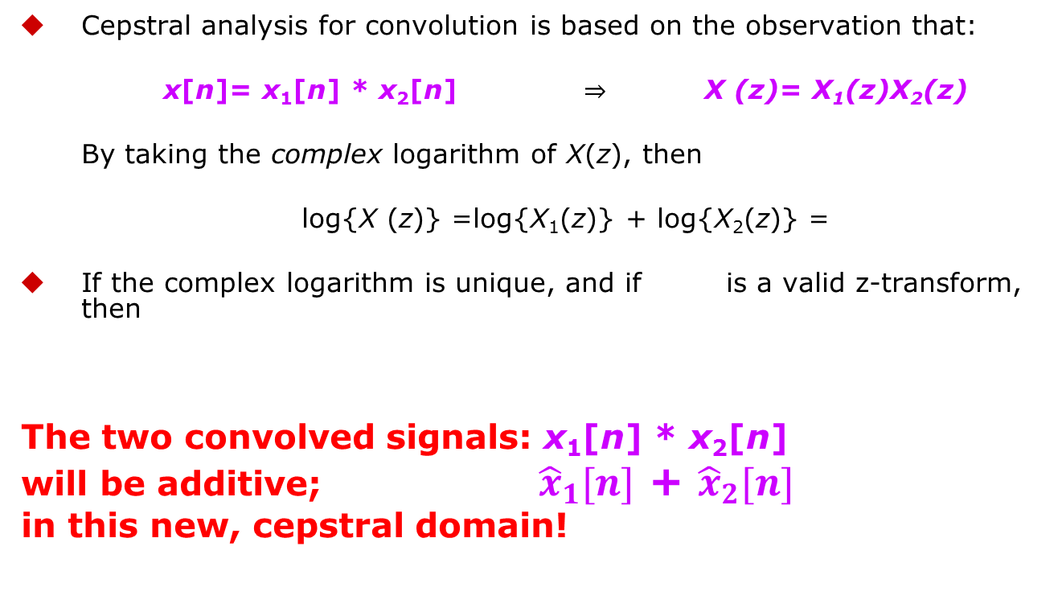
Cepstral Analysis
Cepstral analysis for convolution is based on the observation that:
x[n]= x₁[n] * x₂[n] ⇒ X (z)= X₁(z)X₂(z)
By taking the complex logarithm of X(z), then
log{X (z)} =log{X₁(z)} + log{X₂(z)} =
If the complex logarithm is unique, and if is a valid z-transform, then
The two convolved signals: x₁[n] * x₂[n]
will be additive; ${ \hat{x}}_{1}[n]$ + ${\hat{x}}_{2}[n]$
in this new, cepstral domain!

Slide 54
Cepstral Analysis (cont’d)
If we restrict ourselves to the unit circle, z = e^{jω}, then:
It can be shown that one approach to dealing with the problem of uniqueness is to require that arg{X(e^{jω})} be a continuous, odd, periodic function of ω.

Slide 55
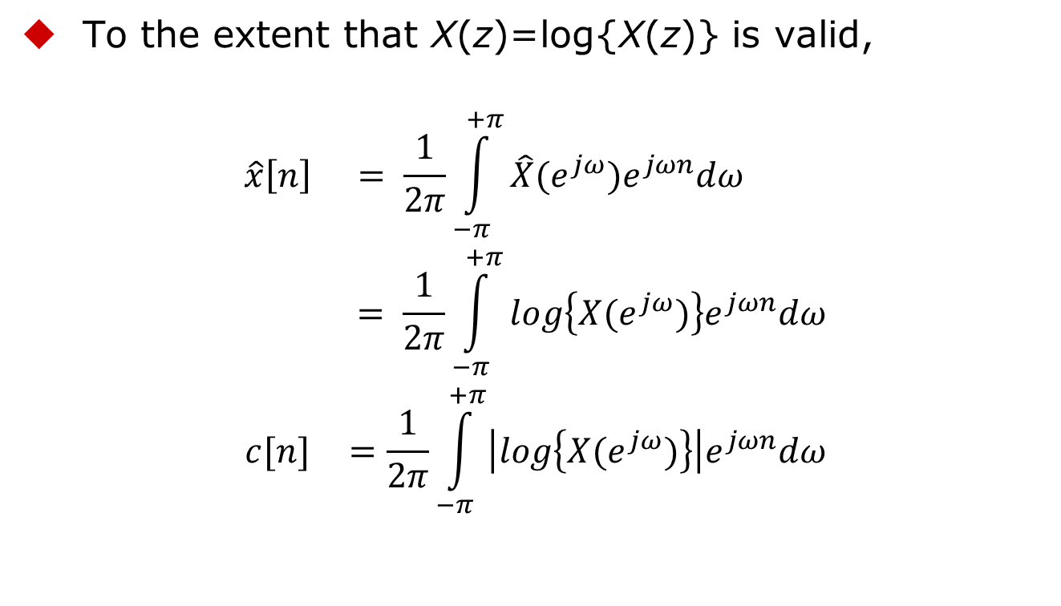
Cepstral Analysis (cont’d)
^
To the extent that X(z)=log{X(z)} is valid,
$$\begin{matrix}\hat{x}\left[n\right] & = \frac{1}{2π}\int_{−π}^{+π}{\hat{X}(e^{jω})e^{jωn}dω} \\ & = \frac{1}{2π}\int_{−π}^{+π}{log\left\{X(e^{jω})\right\}e^{jωn}dω} \\ c[n] & =\frac{1}{2π}\int_{−π}^{+π}{\left|log\left\{X(e^{jω})\right\}\right|e^{jωn}dω}\end{matrix}$$

Slide 56
Cepstral Analysis (cont’d)
It can easily be shown that c[n] is the even part of x[n].
If x[n] is real and causal then x[n], can be recovered from c[n]. This is known as the Minimum Phase condition.

Slide 57
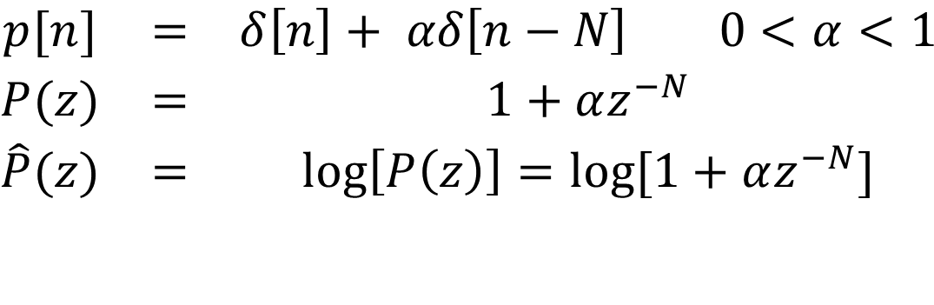
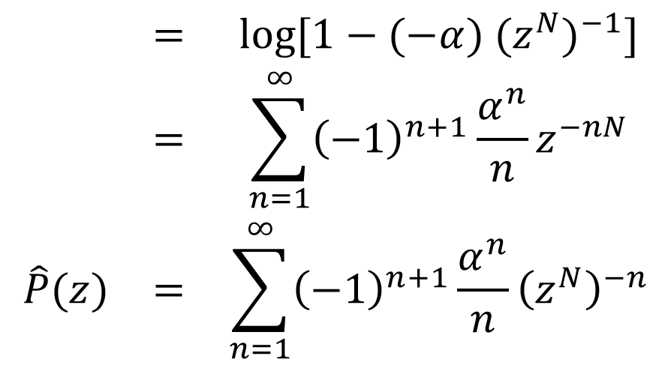
An Example
$$\begin{matrix}p[n] & = & δ\left[n\right]+ αδ\left[n−N\right] 0<α<1 \\ P(z) & = & 1+αz^{−N} \\ \hat{P}(z) & = & \log\left[P\left(z\right)\right]=log⁡[1+αz^{−N}]\end{matrix}$$
$$\begin{matrix} & = & log⁡[1−(−α) {(z^{N})}^{−1}] \\ & = & \sum_{n=1}^{∞}{{\left(−1\right)}^{n+1}\frac{α^{n}}{n}}z^{−nN} \\ \hat{P}(z) & = & \sum_{n=1}^{∞}{{\left(−1\right)}^{n+1}\frac{α^{n}}{n}}{\left(z^{N}\right)}^{−n}\end{matrix}$$

Slide 58
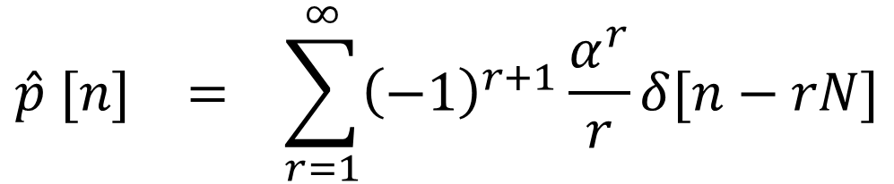
An Example (cont.)
$$\begin{matrix}\hat{p} [n] & = & \sum_{r=1}^{∞}{{\left(−1\right)}^{r+1}\frac{α^{r}}{r}}δ[n−rN]\end{matrix}$$

Slide 59
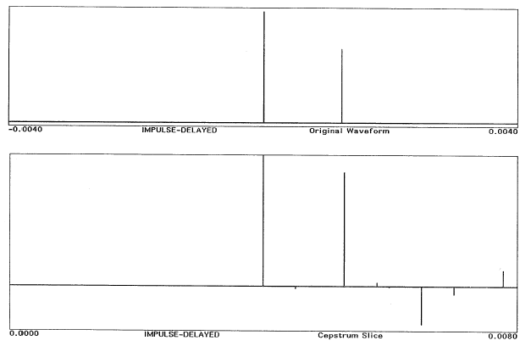
An Example (cont’d)

Slide 60
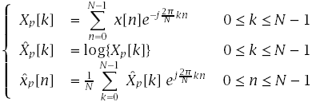
Computational Considerations
We now replace the Fourier transform expressions by the discrete Fourier transform expressions
is a sampled version of . Therefore,
Likewise, where

Slide 61
Computational Considerations (cont.)
To minimize aliasing, N must be large

Slide 62
Cepstral Analysis of Speech
For voiced speech:
For unvoiced speech:
s[n]=w[n]*v[n]*r[n]= w[n]* h_{u}[n].

Slide 63
Cepstral Analysis of Speech
Contributions to the cepstrum due to periodic excitation will occur at integer multiples of the fundamental period.
Contributions due to the glottal waveform (for voiced speech), vocal tract, and radiation will be concentrated in the low quefrency region, and will decay rapidly with n.
Deconvolution can be achieved by multiplying the cepstrum with an appropriate window, l[n].

Slide 64
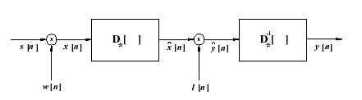
Cepstral Analysis of Speech
Where D* is the characteristic system that converts convolution into addition.
Thus cepstral analysis can be used for pitch extraction and formant tracking.

Slide 65
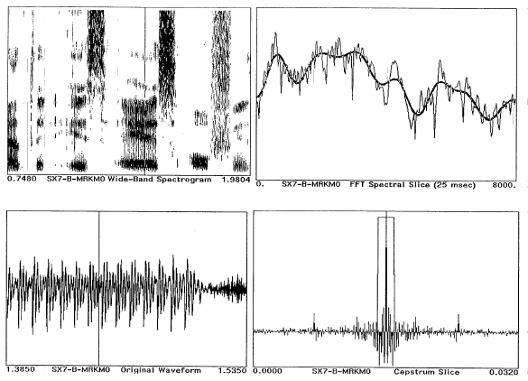
Example of Cepstral Analysis of Vowel (Rectangular Window)

Slide 66
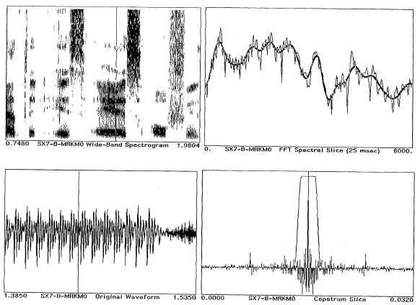
Example of Cepstral Analysis of Vowel (Tapered Window)

Slide 67
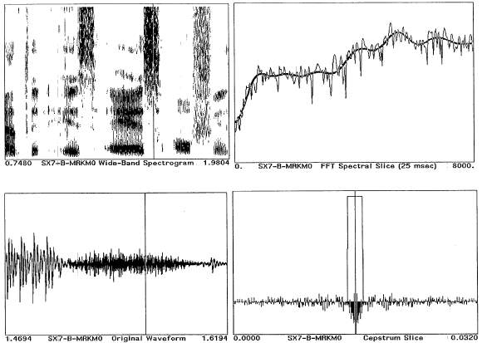
Example of Cepstral Analysis of Fricative (Rectangular Window)

Slide 68
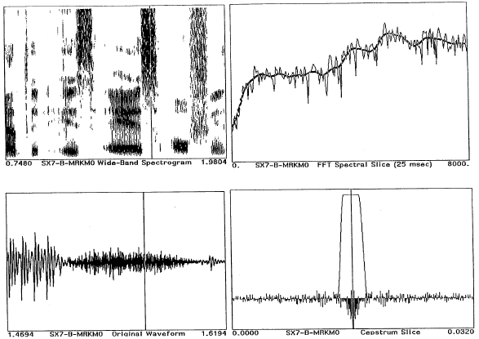
Example of Cepstral Analysis of Fricative (Tapered Window)

Slide 69
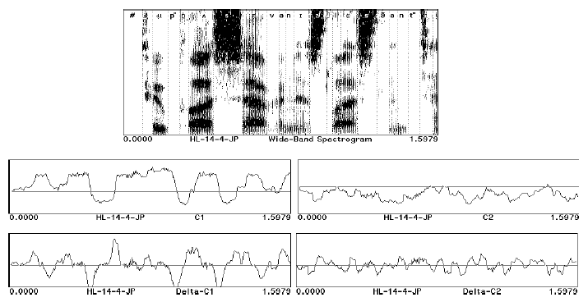
The Use of Cepstrum for Speech Recognition
Many current speech recognition systems represent the speech signal as a set of cepstral coefficients, computed at a fixed frame rate. In addition, the time derivatives of the cepstral coefficients have also been used.

Slide 70
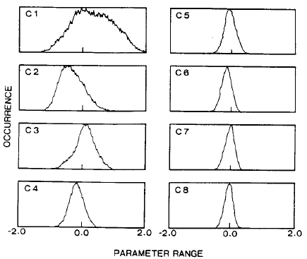
Statistical Properties of Cepstral Coefficients (Tohkura, 1987)
From a digit database (100 speakers) over dial-up telephone lines the following statistics were obtained:

Slide 71
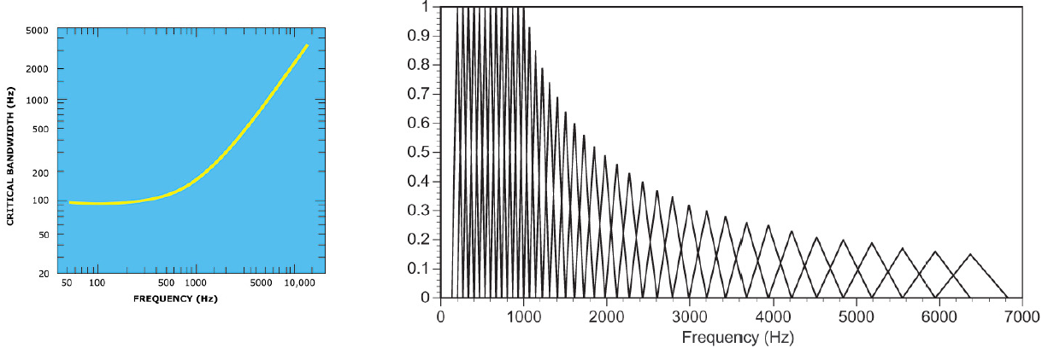
Mel-Frequency Cepstral Representation (Mermelstein & Davis 1980)
Some recognition systems use Mel-scale cepstral coefficients to mimic auditory processing. (Mel frequency scale is linear up to 100 Hz and logarithmic thereafter.) This is done by multiplying the magnitude (or log magnitude) of S(e^{jω}) with a set of filter weights as shown below:

Slide 72
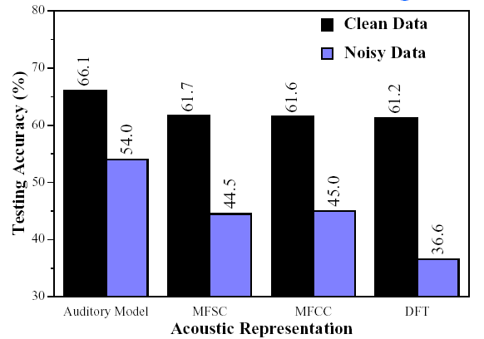
Signal Representation Comparisons
Many researchers have compared cepstral representations with Fourier-, LPC-, and auditory-based representations.
Cepstral representation typically out-performs Fourier-and LPC-based representations.
Example: Classification of 16 vowels using ANN (Meng, 1991)

Slide 73
Signal Representation Comparisons (cont.)
Performance of various signal representations cannot be compared without considering how the features will be used, i.e., the pattern classiffication techniques used. (Leung, et al., 1993).

Slide 74
Things to Ponder...
Are there other spectral representations that we should consider (e.g., models of the human auditory system)?
What about representing the speech signal in terms of phonetically motivated attributes (e.g., formants, durations, fundamental frequency contours)?
How do we make use of these (sometimes heterogeneous) features for recognition (i.e., what are the appropriate methods for modeling them)?

Slide 75
References
Tohkura, Y., “A Weighted Cepstral Distance Measure for Speech Recognition," IEEE Trans. ASSP, Vol. ASSP-35, No. 10, 1414-1422, 1987.
Mermelstein, P. and Davis, S., “Comparison of Parametric Representations for Monosyllabic Word Recognition in Continuously Spoken Sentences," IEEE Trans. ASSP, Vol. ASSP-28, No. 4, 357-366, 1980.
Meng, H., The Use of Distinctive Features for Automatic Speech Recognition, SM Thesis, MIT EECS, 1991.
Leung, H., Chigier, B., and Glass, J., “A Comparative Study of Signal Representation and Classification Techniques for Speech Recognition," Proc. ICASSP, Vol.II, 680-683, 1993.

Slide 76
The End

